Slide 1
ANTWERP’S AIRBNB PRICE & SCENARIO ANALYSIS
MADE BY:
GARGI JAKHMOLA
SHYAM KUMAR
SRIJA POLEPALLI
(GROUP 1)

Slide 2
OBJECTIVE
To develop an interactive Power BI dashboard for Airbnb listings in Antwerp, enabling property owners and stakeholders to analyze listing performance and explore revenue scenarios without relying on machine learning.
Analyze Performance: Evaluate listing trends, pricing, and availability patterns in Antwerp.
Simulate Outcomes: Utilize "What-If" analysis to forecast revenue under varying market conditions.
Inform Decisions: Identify high-performing property types and seasonal opportunities.

Slide 3
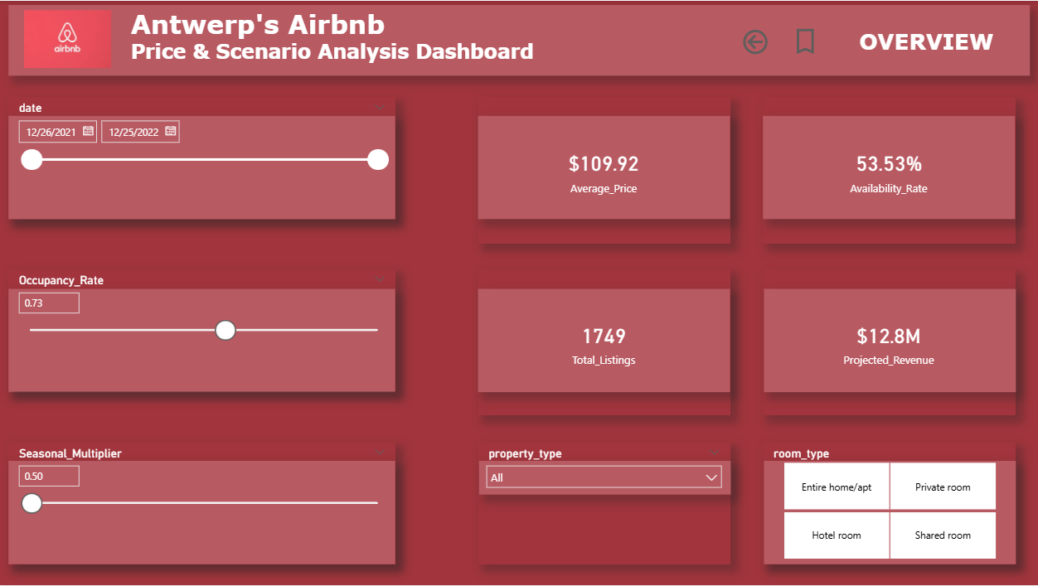
DASHBOARD OVERVIEW (1/3)

Slide 4
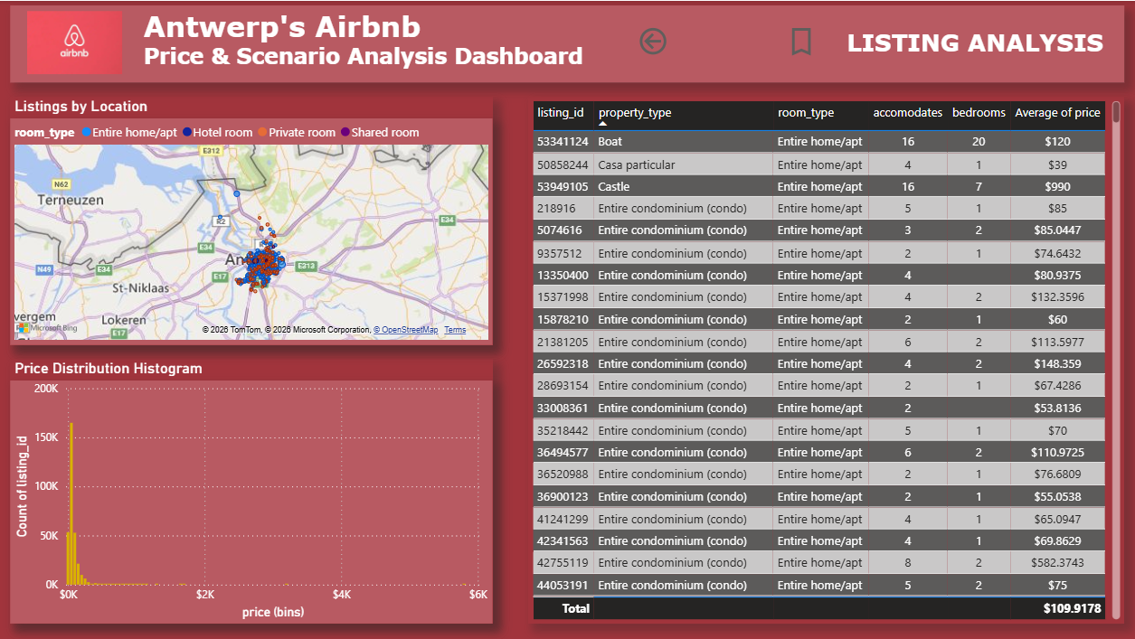
DASHBOARD OVERVIEW (2/3)

Slide 5
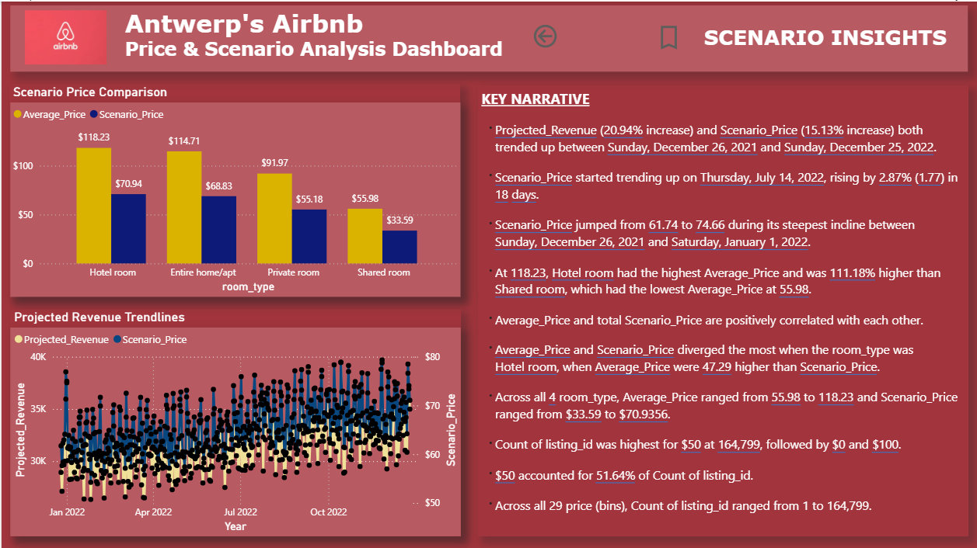
DASHBOARD OVERVIEW (3/3)

Slide 6
EXECUTIVE SUMMARY
Average Listing Price | $109.92
Total Active Listings | 1,749
Availability Rate | 53.53%
Current Projected Revenue | $12.07M (based on 0.43 occupancy and 0.80 seasonal multiplier)

Slide 7
INTERACTIVE "WHAT-IF" ANALYSIS
Occupancy Rate Slider: Simulates demand fluctuations from 0% to 100%.
Seasonal Multiplier: Adjusts pricing for off-season (0.80) or peak-season (1.20) scenarios.
Dynamic Impact: KPI cards and revenue trends update instantly to model best-case vs. worst-case outcomes.

Slide 8
LISTING ANALYSIS
Geospatial Mapping: Visualization of listing density across Antwerp neighborhoods.
Property Diversity: Analysis includes everything from standard condos to unique stays like Boats and Castles.
Price Distribution: Histogram identifying the most common price points and market outliers.

Slide 9
SCENARIO INSIGHTS
Price Comparison: Visual gap analysis between standard Average Price and Simulated Scenario Price.
Revenue Trends: Time-series tracking of projected revenue throughout 2022.
Key Narrative:
Hotel rooms hold the highest average price at $118.23.
Low-cost listings ($50 range) account for 51.64% of total volume.

Slide 10
TECHNICAL ARCHITECTURE
Data Model: Star schema linking Listings, Reviews, and Calendar data.
Advanced DAX Logic:
Projected Revenue: Multiplies adjusted price by projected occupied nights.
Scenario Price: Dynamically adjusts based on the seasonal multiplier.
Data Transformation: Power Query used to categorize properties by bed count and guest capacity.

Slide 11
KEY BUSINESS INSIGHTS
Higher accommodation capacity increases price but not proportionally revenue unless occupancy improves.
Listings with consistent availability generate more predictable revenue than high-price but low-availability listings.
Seasonal price adjustments significantly amplify revenue during high-demand periods.
Location and property type jointly drive pricing strategy.

Slide 12
BUSINESS VALUE
The dashboard enables:
Pricing optimization decisions
Revenue forecasting
Market benchmarking
Demand scenario planning
Hosts and analysts can move from descriptive analytics to predictive decision support.

Slide 13
CONCLUSION & STRATEGIC VALUE
This project demonstrates how Power BI can transform raw operational data into an interactive decision intelligence system using advanced modeling, DAX calculations, and scenario simulation.
Agility: The dashboard allows for rapid recalculation as market demand shifts.
Opportunity: Targeted insights into which listing types (e.g., Hotel rooms) benefit most from scenario changes.
Scalability: Built with a refreshable backend for ongoing market monitoring.

Slide 14
THANK YOU

